Slide 1
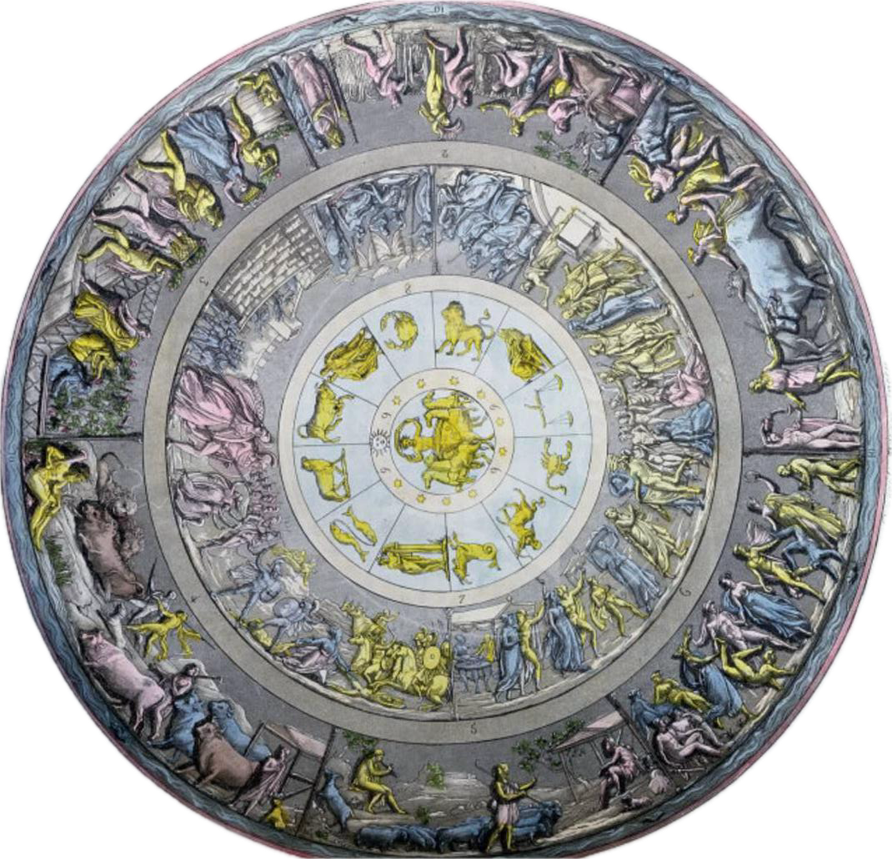
Victorian Homer: A Tale of Two Genres
Notes:
An interpretation of the Shield of Achilles design described in Book 18 of the Iliad, by Angelo Monticelli (1778-1837)

Slide 2
Epic
Ekphrasis
The Iliad as origin
The Iliad as origin

Slide 3
Epic
Ekphrasis
The Iliad as origin
Victorian passion for (textual) translation
The Iliad as origin
Victorian passion for (another form of) translation

Slide 4
Epic
Ekphrasis
The Iliad as origin
Victorian passion for (textual) translation
Who and what is it for?
The Iliad as origin
Victorian passion for (another form of) translation
Who and what is it for?

Slide 5
The Iliad as Origin
Notes:
An interpretation of the Shield of Achilles design described in Book 18 of the Iliad, by Angelo Monticelli (1778-1837)

Slide 6
There are few other epics known pre-Homer:
  Epic of Gilgamesh (2100-1200BC)
The description of Achilles’ shield (Book 18, lines 478-608) is the first (extant) ekphrasis:
  “The verbal representation of visual representation” (Heffernan)
  Essential is enargeia (“vividness”, intense descriptiveness, a quality that appeals to the senses)

Slide 7
Translation
Notes:
An interpretation of the Shield of Achilles design described in Book 18 of the Iliad, by Angelo Monticelli (1778-1837)

Slide 8
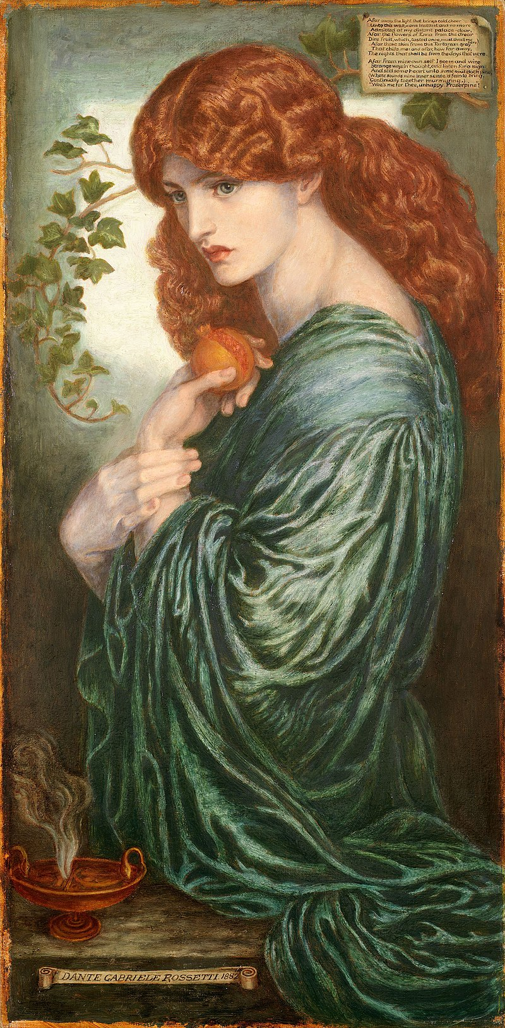
Afar away the light that brings cold cheer
Unto this wall, – one instant and no more
Admitted at my distant palace-door
Afar the flowers of Enna from this drear
Dire fruit, which, tasted once, must thrall me here.
Afar those skies from this Tartarean grey
That chills me: and afar how far away,
The nights that shall become the days that were.
Afar from mine own self I seem, and wing
Strange ways in thought, and listen for a sign:
And still some heart unto some soul doth pine,
(Whose sounds mine inner sense in fain to bring,
Continually together murmuring) —
'Woe me for thee, unhappy Proserpine’.

Slide 9
Immense translation activity of the Iliad and the Odyssey in the Victorian period (1837-1901)
  35 complete translations of the Iliad
  23 complete translations of the Odyssey
  Blank verse
  Rhyming pentameter
  Prose
  Hexameter
  Spenserian stanzas
  “Literally translated”

Slide 10
Alexander Pope (1715-20)
Samuel Butler (1898)
Two cities radiant on the shield appear,
The image one of peace, and one of war.
Here sacred pomp and genial feast delight,
And solemn dance, and hymeneal rite;
Along the street the new-made brides are led,
With torches flaming, to the nuptial bed:
The youthful dancers in a circle bound
To the soft flute, and cithern's silver sound:
Through the fair streets the matrons in a row
Stand in their porches, and enjoy the show.
He wrought also two cities, fair to see and busy with the hum of men. In the one were weddings and wedding-feasts, and they were going about the city with brides whom they were escorting by torchlight from their chambers. Loud rose the cry of Hymen, and the youths danced to the music of flute and lyre, while the women stood each at her house door to see them.

Slide 11
Victorian anxieties about:
  The fitness, nobility, or honorability of the age
Action, in those old days, was easy, was voluntary, for the divine worth of human things lay acknowledged. . . . How changed in these new days! . . . Heroic Action is paralysed; for what worth now remains unquestionable with [the youth of these times]?
Thomas Carlyle, “Characteristics” (1831)

Slide 12
Epic as a genre in transition
  A long narrative poem in elevated style presenting characters of high position in adventures forming an organic whole through their relation to a central heroic figure and through their development of episodes important to the history of a nation or race. (Harmon & Holman (1999))
    Arthurian epics (Tennyson, Morris, Swinburne)
    Icelandic (Morris)
    Contemporary
      Verse novels (often tragi-comic) (Clough, Barrett Browning)
      Three-volume novels (Eliot, Dickens)

Slide 13
Ekphrasis as a matter of:
  Translating?
  Transposing?
  Transforming?
  Transferring?
the physical work of art to text
The same issues of translation as with translating Homer:
  Content
  Form
  Effect/impact

Slide 14
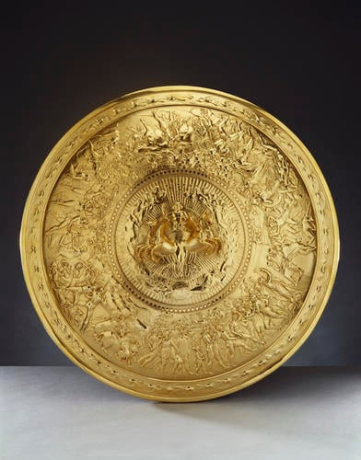
Ekphrasis as a matter of translating / transposing / transforming / transferring the physical work of art to text
Also went back again:
  Philip Rundell commission
  Designed by John Flaxman
  Silver-gilt convex shield
  Central medallion
  Based on Pope’s translation

Slide 15
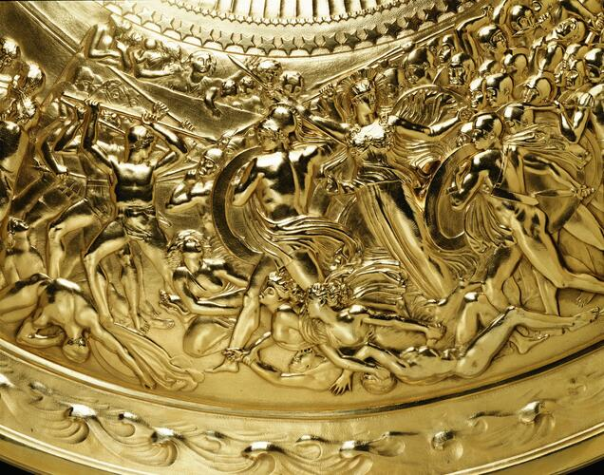

Slide 16
For whom, and for why?
Notes:
An interpretation of the Shield of Achilles design described in Book 18 of the Iliad, by Angelo Monticelli (1778-1837)

Slide 17
Many European nations saw the Classical period as foundational to their own stories:
  John Stuart Mill (1806-1873) suggested “the battle of Marathon, even as an event in British history, is more important than the battle of Hastings” because “the true ancestors of the European nations are not those from whose blood they are sprung, but those from whom they derive the richest portion of their inheritance”.
But access is inevitably restricted:
  Class
  Gender
  Religious background

Slide 18
Victorian anxieties about:
  The fitness, nobility, or honourability of the age
Action, in those old days, was easy, was voluntary, for the divine worth of human things lay acknowledged. . . . How changed in these new days! . . . Heroic Action is paralysed; for what worth now remains unquestionable with [the youth of these times]?
Thomas Carlyle

Slide 19
Strong trend towards increased access:
  To classical education, and plainer translations, to appreciate epic
  To aesthetic education, and public museums and galleries, to appreciate ekphrasis (and the art it describes)
Self-taught female (and male) poets translating and imitating Greek classics (epic, but also tragedy)
The rise of art history as a discipline, with ekphrasis as a central form

